Slide 1
Unit C: Animal Management
Essential Standard 5.00: Understand management of agriculture animals.

Slide 2
Objective 5.01
Classify animal housing, facilities and waste management.

Slide 3
Beef Housing and Facilities
Types of Operations
  producers should plan facilities and equipment to suit the various types of beef operation(s).
    Cow-Calf Producers
    Seedstock or Purebreed
    Cattle Feeders
        Stocker Operations
        Feedlot

Slide 4
Types of Housing
Confinement Barns
    Cold
      Opens to environment on one side
        Uses a pole-type building with an open-span structure to make it easier to remove waste
        Can use various solid bedded or slotted floors

Slide 5
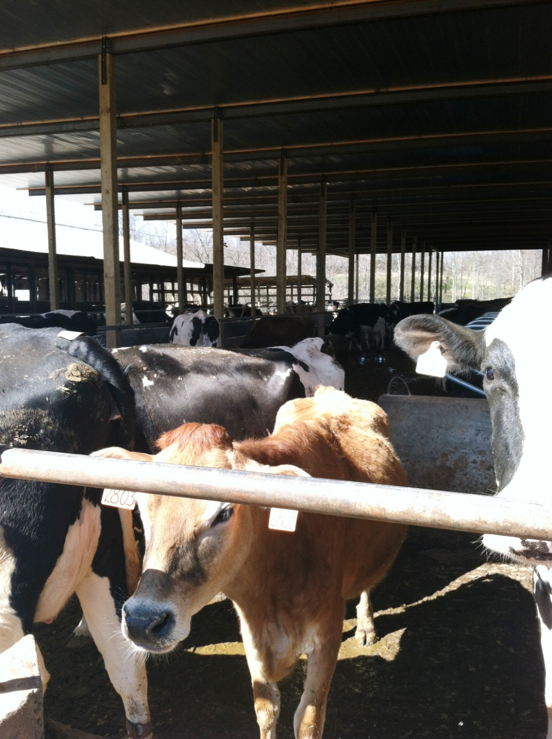
Cold Confinement
This picture was taken at Cornwell Dairy in Cleveland County.

Slide 6
Types of Housing
Confinement Barns
    Warm
      closed, insulated and kept warm.
        Most expensive type of facility
        Used in colder climates
        Can use solid bedded, slotted or solid flushing floor systems

Slide 7
Types of Housing
  Open Feedlot
    no buildings, just windbreak fences and sunshades to protect from wind, snow, and sun
      Unpaved floors
        some concrete around feeding and watering stations
      Requires more land area
      Floors are typically dirt, therefore drainage and runoff controls are important

Slide 8
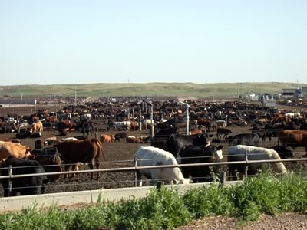
Open Feedlot
Courtesy: http://www.extension.iastate.edu/pages/communications/epc/Fall04/feedlots.html

Slide 9
Types of Housing
  Open Barn and Feedlot
    open front barn and feedlot.
      Provides protection from environmental elements
        Midwestern part of US
      Unpaved floors
        some concrete around feeding and watering stations
  Feeding Barn and Lot
    same system as open barn and feedlot except feed bunks are located in the barn

Slide 10
Types of Housing
  Pasture
    typically used for cow-calf producers and requires minimal facilities
      Important to manage pastures to maximize growth potential of forages, distribute manure and control parasites
        Pasture Rotation
          cycles animals through a series of pastures.
        Strip Grazing
          providing animals with smaller sections of grass every few days
          Maximizes forage growth and land utilization
          Requires more labor

Slide 11
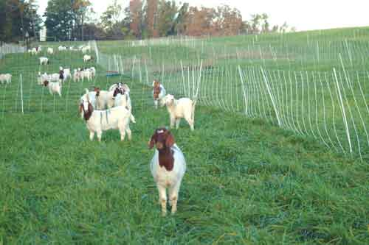
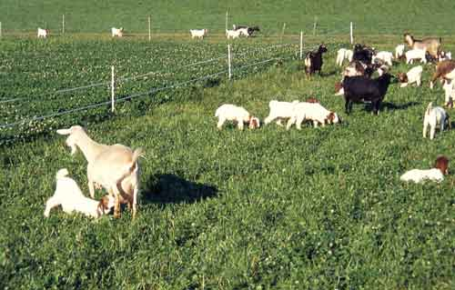
Strip Grazing
Courtesy: http://www.luresext.edu/goats/training/pastures.html

Slide 12
Beef Operation Considerations
  Number of Cattle
    determined by the resources available and the type of operation

Slide 13
Beef Operation Considerations
  Amount of Land
    varies depending on operation
        Feedlots
          5 acres for every 500 head of cattle
        Partial Confinement & Pasture
          depends of location of facilities, pasture management, age of animals, etc.

Slide 14
Beef Operation Considerations
  Location and Environmental Factors
    Easy access to roads
    Space for expansion
    Movement of cattle
    Environmental Considerations- odor, wind, dust, runoff

Slide 15
Beef Operation Considerations
  Feed Storage and Handling
    systems vary depending on type of facilities
  Money and Labor
    Input costs to build and maintain facilities
    Labor supply

Slide 16
Beef Cattle Equipment
  Corrals
    needed for all types of beef cattle enterprises

Slide 17
Beef Cattle Equipment
Corrals Parts
  Holding Pen
  Sorting Pen
    workers can separate cattle into smaller groups
  Working Chute
    crowding pen that again moves cattle into a smaller group
    moved to an “alleyway” system where they are funneled into an individual line
  Headgate
    holds cattle

Slide 18
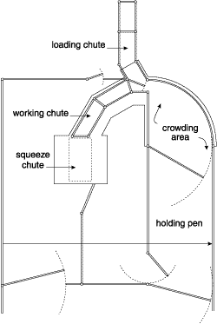
Corrals

Slide 19
Beef Cattle Equipment
Advantages of corrals:
    Easier to handle cattle
    Reduces labor
    Saves time
    Safety of workers and animals
    Reduces stress on animals

Slide 20
Dairy Housing and Facilities
Types of Operations
  Intensive Dairy Production
  Pasture Dairy Production

Slide 21
Dairy Housing and Facilities
Types of Housing
  Stall Barns
    cows confined to a stanchion or tie stall
      Structure at the front of stall usually serves as feed bunk with an automated watering system
      Waste removed in center aisle by motorized or automated equipment

Slide 22
Dairy Housing and Facilities
Types of Housing
  Free Stall Barn
    cows maneuver throughout barn
      Stalls are a bedded area for cattle to rest
      Facility may be fully or partially enclosed and temperature regulated
      Floors may be dirt, solid concrete or slatted
      Waste removed by motorized equipment

Slide 23
Dairy Housing and Facilities
Types of Housing
  Pasture
    Cows kept on pasture continuously or for portions of the day
    Producers often use a combination of pasture and some type of barn facility
    Replacement heifers are often raised on pasture

Slide 24
Dairy Housing and Facilities
Types of Housing
  Portable Hutches
    used to house young calves
  Heifer Barns
    used to house replacement heifers after portable hutches. Animals can be grouped in pens or in individual stalls

Slide 25
Dairy Housing and Facilities
Dairy Cattle Equipment
  Headlocks
    modified headgate system where larger numbers of cattle can be restrained
    typically attached to feed bunks so animals are accustomed putting head into latch system
    routine veterinary care and reproductive related procedures are usually administered
  Headgate and Working Chute
    same system as what is used for beef cattle
    used for more intensive veterinary procedures and hoof trimming

Slide 26
Dairy Housing and Facilities
Dairy Cattle Equipment
  Milking Equipment
    Milking Parlors- separate room/area where cattle are milked
      Most common method of milking cows
      Includes a pit where workers operate equipment used to milk animals
      Most common milking parlor design is the herringbone
    Cattle kept in stall barns may use pail, suspension or pipeline milking system or be moved to a milking parlor

Slide 27
Dairy Housing and Facilities
Dairy Cattle Equipment
  Milkhouse
    room where milk is filtered, cooled and stored in stainless steel tanks

Slide 28
Swine Housing and Facilities
Types of Operations
  producers plan facilities based on type on type of operation
    Sow
    Nursery
    Grow-Finish
    Farrow-to-Finish

Slide 29
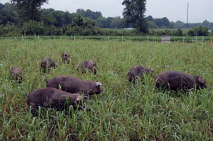
Swine Housing and Facilities
Types of Housing
  Pasture or outdoor without climate controlled buildings
http://www.cefs.ncsu.edu/whatwedo/researchunits/alternativeswine.html

Slide 30
Swine Housing and Facilities
Types of Housing
  Confinement Houses
    Cold
      may be open on one or more sides
      used mainly for finishing hogs
    Warm
      controls temperature, moisture, odor and airborne diseases through a ventilation system
      used mainly for breeding, farrowing and young pigs
      most North Carolina swine operations use warm confinement

Slide 31
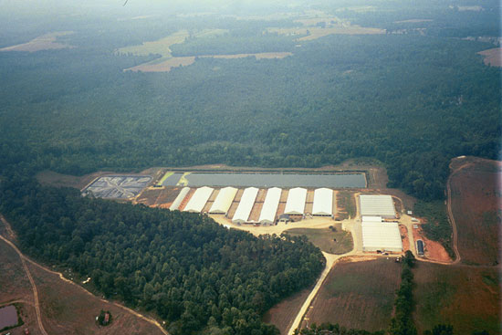
Aerial view of Barham Farm, Zebulon, North Carolina.
http://www.cals.ncsu.edu/waste_mgt/smithfield_projects/ambient%20digester/ambientdigester.htm

Slide 32
Swine Housing and Facilities
Swine Operation Considerations
  Location and Environmental Considerations
    Odor
    Access to roads, power and water
  Proximity
    swine operations are highly vertically integrated
    need to be in an area that has other operations of similar type

Slide 33
Swine Housing and Facilities
  Regulations
    restriction on the construction of new facilities.
    special waste management considerations
  Feed Storage and Handling
    confinement facilities typically use feed/grain bins to store feed
  Money and Labor
    Input costs to build and maintain facilities

Slide 34
Swine Housing and Facilities
Swine Equipment
  Feeding and Watering Systems
    confinement swine facilities have automatic feeding and watering systems
      Automatic feeding and watering
        more expensive, but they save on labor
      Hand or non-automatic systems cost less
        require more labor

Slide 35
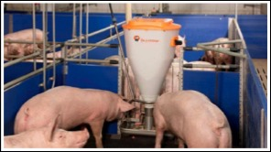
http://www.bigdutchmanusa.com/swineproduction/

Slide 36
Swine Housing and Facilities
Swine Equipment
  Floor Types
    Solid- usually made of concrete
    Partially Slotted- a portion of the floor is slotted with another section being solid
    Totally Slotted- entire floor is slotted to allow for continuous removal of waste

Slide 37
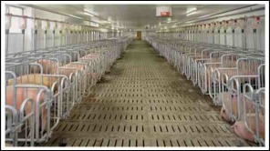
http://www.bigdutchmanusa.com/swineproduction/

Slide 38
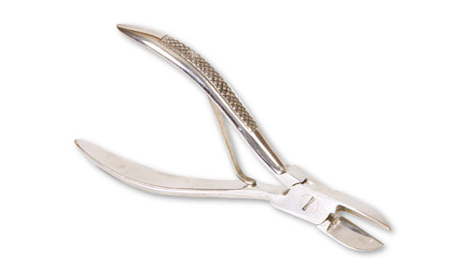
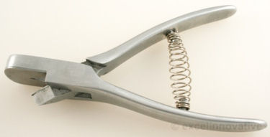
Swine Housing and Facilities
Swine Equipment
  Farrowing hog enterprises require small equipment such as castrating knives, ear notchers, and needle teeth clippers

Slide 39
Swine Housing and Facilities
  Gestation Crates/Stalls
    animals spend 24 hours a day in crate during gestation period
      meet specific nutritional needs of each animal
      removes potential for injury from other aggressive sows
    very controversial method or housing pregnant animals
      many larger companies are phasing out
        moving to a group housing system where animals can go into individual pens if they choose, but can also come out to move and socialize with other females

Slide 40
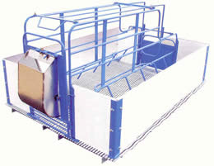
Swine Housing and Facilities
  Farrowing Crates
    Animals moved into crates a few days prior to farrowing
    Reduces the number of piglets injured or killed

Slide 41
Poultry Housing and Facilities
Types of Operations
  Egg Production
  Broiler Production
  Replacement Pullet Production
  Egg Hatcheries

Slide 42
Poultry Housing and Facilities
Confinement Houses
  clear span structure with insulated ceiling and walls to prevent heat stress
  ventilation is a key consideration in building design

Slide 43
Poultry Housing and Facilities
Broilers and Turkeys
  Usually have dirt floors covered with wood shavings or straw
  Lights are on 24 hours a day

Slide 44
Poultry Housing and Facilities
Laying Flocks
    Use wire cages
      save space
      cleaner eggs
    Artificial light
      controlled by timers
      laying hens require at least 14 hours of light per day

Slide 45
Poultry Housing and Facilities
Replacement Pullets
  Laying pullets
    raised in cages for brooding or until moved to laying houses
  Broiler breeder pullets
    raised in confinement houses on dirt floors
  Lights are controlled to regulate sexual maturity and egg production

Slide 46
Range or Outside Structures
  Popular method of housing poultry raised by small scale or niche producers
  Commercial trend is moving away from this method
    land requirements
    diseases
    predators
    Weather

Slide 47
Egg Hatcheries
  located separately from production facilities
  include large scale incubators to hatch eggs
  equipment to process, sort and transport chicks
  shipment to a production facility

Slide 48
Poultry Operation Considerations
  Location and Environmental Considerations
    Access to roads, electricity, water
    Odor, waste management and mortality management
  Proximity
    poultry operations are highly vertically integrated
      need to be in an area that has other operations of similar type in order to secure a contract with a company

Slide 49
Poultry Operation Considerations
  Feed Storage and Handling
    confinement facilities typically use feed/grain bins to store feed.
  Money and Labor
    Input costs to build and maintain facilities

Slide 50
Poultry Equipment
Brooders
  using infrared heat lamps to keep young chicks at optimal temperature
  typically brooded on the floor in a section of the poultry house
    hover guard to keep chicks from wandering away from heat source
        90-95 degrees Fahrenheit
        reduced 5 degrees per week until reaches 70-75 degrees Fahrenheit
        Take temperature 3” from floor

Slide 51
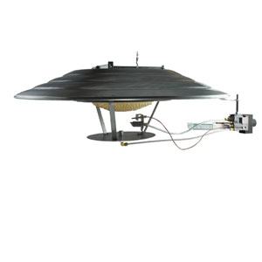
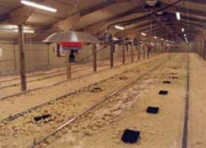
Brooder

Slide 52
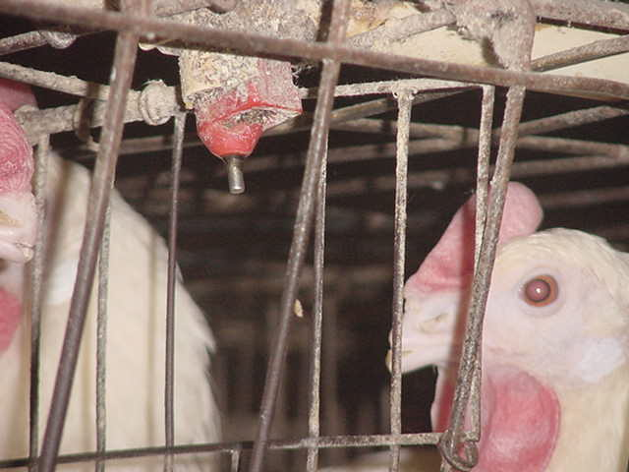
Poultry Equipment
Feeding and Watering Systems
  highly automated in all types of poultry houses

Slide 53
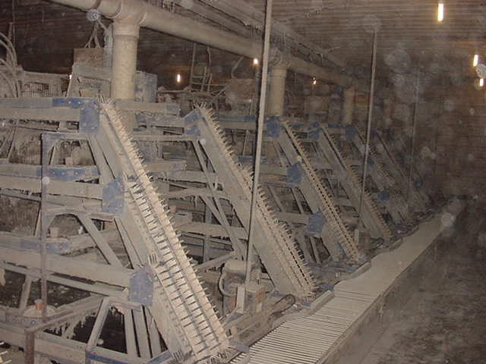
Poultry Housing and Equipment

Slide 54
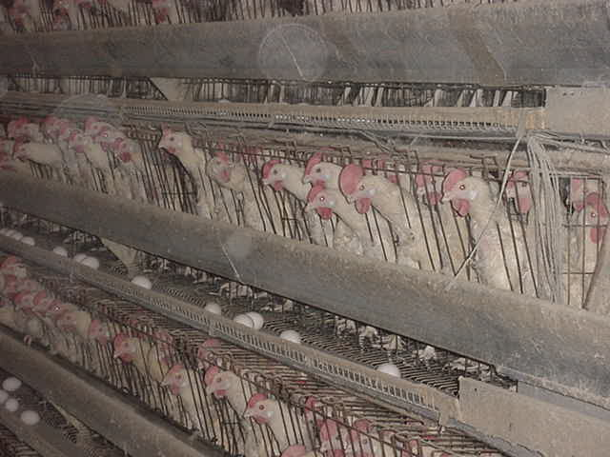
Poultry Housing and Equipment

Slide 55
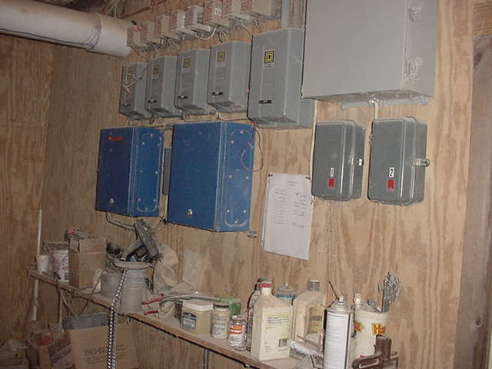
Poultry Housing and Equipment

Slide 56
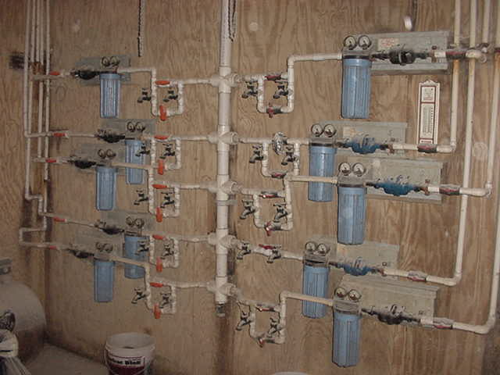
Poultry Housing and Equipment

Slide 57
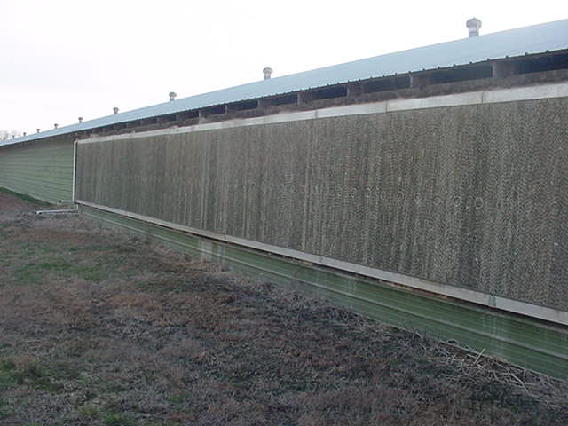
Poultry Housing and Equipment

Slide 58
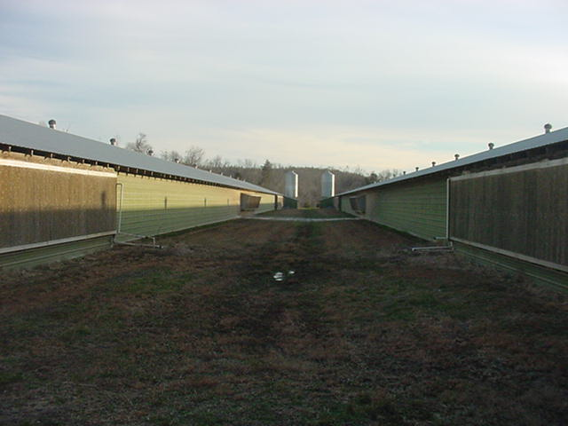
Poultry Housing and Equipment

Slide 59
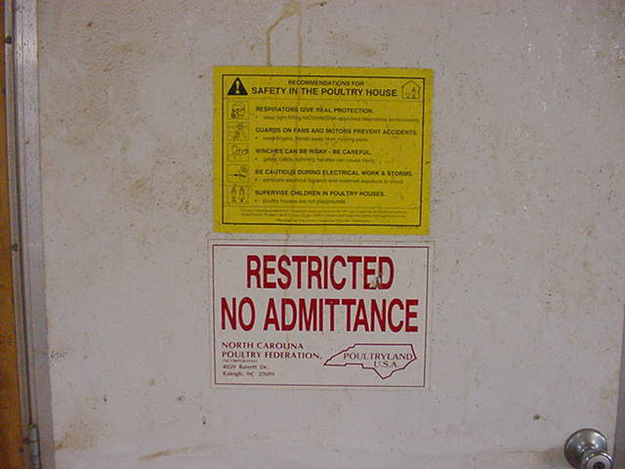
Poultry Housing Bio-security

Slide 60
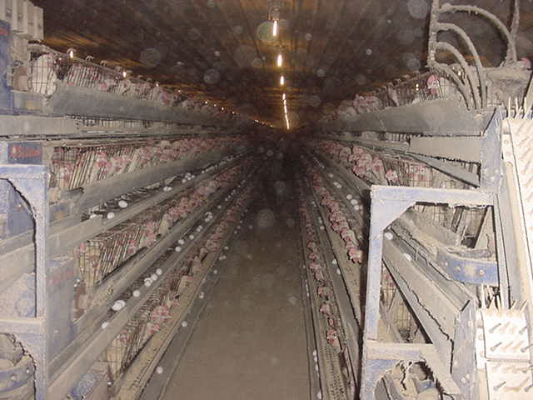
Poultry Housing and Equipment

Slide 61
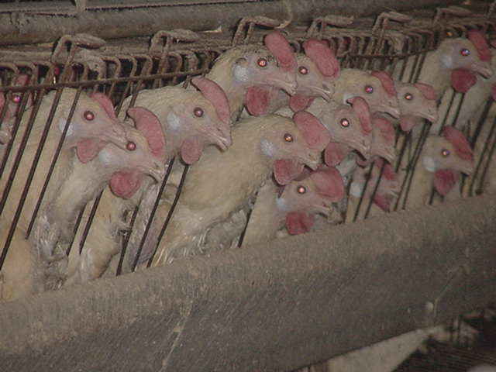
Poultry Housing and Equipment

Slide 62
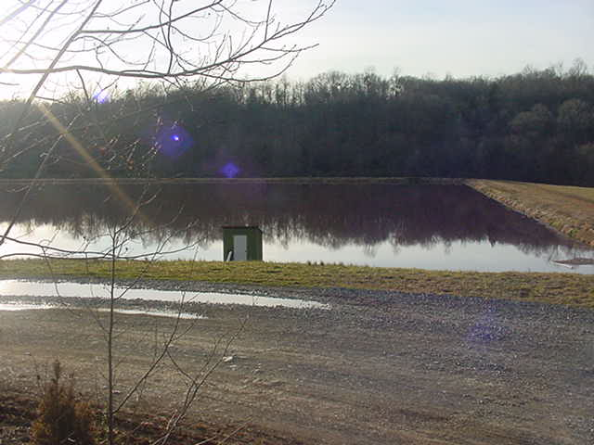
Poultry Housing and Equipment

Slide 63
Animal Waste Management Regulations
Confined Animal Feeding Operations (CAFO)
  used to describe operations that raise large numbers of animals in a confined setting

Slide 64
Animal Waste Management Regulations
It is a violation of state law for waste to reach surface water
  A $10,000 per day penalty may be assessed if there is a man-made conveyance such as a pipe or a ditch to route waste away from a holding pit or lagoon even if no waste is actually discharged
It is against the law for anyone to cause a water quality standard violation

Slide 65
Animal Waste Management Regulations
Senate Bill 1217
  mandates the number of animals that require a waste management plan and permit
    250 or more swine
    100 or more confined cattle
    75 or more horses
    1,000 or more sheep
    30,000 or more confined poultry

Slide 66
Animal Waste Management Regulations
Animal waste management system operators must be certified.
In addition to state regulations, local county and city regulations such as zoning and facility locations also apply.
In addition to fines and lawsuits brought by governmental agencies, third-party lawsuits can be bought by individuals or organizations against livestock and poultry operations.
It is easier to prevent animal waste problems than to correct them.

Slide 67
Animal Waste Management Regulations
Types of Waste Management Systems
  Type A Systems- primarily rely on anaerobic lagoon and soil/plant systems for the treatment of animal wastes with low fiber such as swine and poultry.
  Type B Systems- primarily rely on soil/plant systems for the treatment of animal waste with high-fiber such as cattle, horses, and sheep.

Slide 68
Animal Waste Management Regulations
Components of a North Carolina Animal Waste Management Plan
  Odor Control
    from decomposing manure, feed, and carcasses
  Insect Control
    eliminates or reduces causes of insects and uses approved materials to control.
  Animal Mortality
    approved methods to quickly dispose of dead animals.
  Riparian Buffers
    vegetative buffers.

Slide 69
Animal Waste Management Regulations
Components of a North Carolina Animal Waste Management Plan
  Waste and Soil Testing
    both the animal waste and the soil on which it is applied must be tested.
  Record Keeping
    must be done to include soil and waste analysis reports as well as land application dates and rates for each application site.
  Waste Application Rates
    follow the waste utilization plan.
  Emergency Management
    plan to manage disasters from flood, fire, disease, etc.

Slide 70
Animal Waste Management Regulations
Components of a Waste Utilization Plan
  Source of nutrients
  Amount of nutrients
  Placement of nutrients
  Timing of nutrient applications

Slide 71
Animal Waste Management Regulations
Best Management Practices
  methods that reduce the loss of nutrients thereby reducing the potential for negative environmental impact. Examples:
    Buffers
      distances from streams, homes, or property lines
    Grassed Waterways
      natural or constructed water runoff
      helps control erosion
    Conservation Tillage
      using a no till drill so soil surface is not disturbed

Slide 72
Animal Waste Management Regulations
Best Management Practices
    Strip Cropping
      growing alternating crops in strips that follow the contour of the land
    Contour Planting
      planting across a slope while following the contour of the land
    Crop Residue Management
      any tillage method that leaves crop residue.
    Coastal Bermuda grass
      removes high amounts of nutrients from the soil as well as controls erosion

