Slide 1
Supervised Agriculture Experience
Objective 2.01
SAE & Career Selection
ANS 2- Livestock

Slide 2
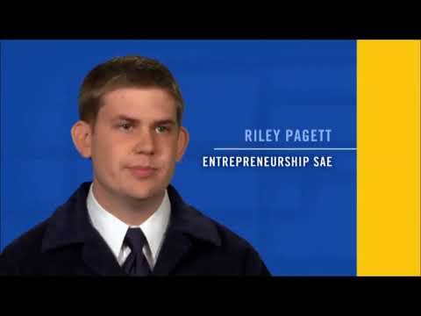

Slide 3
Supervised Agricultural Experiences
The purpose of the SAE is to gain work experience in agriculture and build life skills.

Slide 4
What is SAE?
SAE is a project completed outside of class time that deals with any division of agriculture
Plants
Animals
Agriculture Business
Agriculture Based Science Experiments

Slide 5
Types of SAE
There are SIX types of SAE’s
Entrepreneurship
Experimental
Analytical
Placement
Exploratory
Improvement

Slide 6
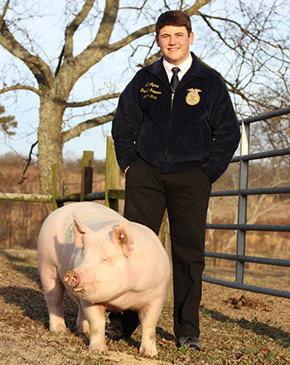
Entrepreneurship
Planning, implementing, operating and assuming financial risks in an agricultural business or farming activity such as raising hogs or operating a farm supply store.
Record Book: Type of enterprise, amount of items bought or sold, expenses, income, efficiency factors, etc.

Slide 7
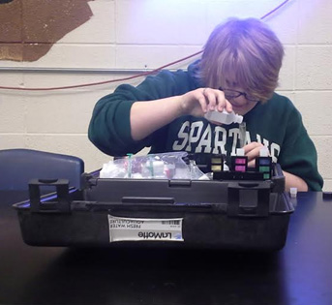
Experimental
Planning and conducting an agricultural experiment using the scientific process or scientific method such as comparing different levels of protein on animal growth.
Record Book: Review of literature, hypothesis, data log, findings, recommendations, etc.

Slide 8
Analytical
Identify an agricultural problem that cannot be solved by experiments and design a plan to investigate and analyze the problem such as a marketing display.
Record Book: Title of activity, identification of problem, background information, steps to solve problem, project log of what was done, results and recommendations.

Slide 9
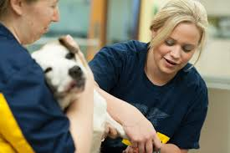
Placement
Placing students in jobs outside of regular classroom hours that may be paid or unpaid work such as working at a farm supply store or on a poultry farm.
Record Book: Training agreement signed by the student, teacher, employer and parent or guardian stating which each will do, record of work, hours and income.

Slide 10
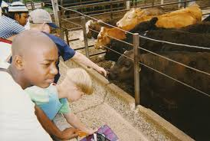
Exploratory
Helps students learn about agriculture and become aware of possible agricultural careers through short times spent observing, shadowing or helping such as
attending a career
day, interviewing a
veterinarian or
assisting a horse
owner.
Record Book: Date, activity, observation and comments & hours

Slide 11
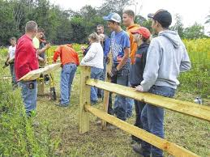
Improvement
A series of activities that improves the value or appearance of the place of employment, school,
home or community; the efficiency of a business or an enterprise; or the living conditions of the family. Examples include building a fence, computerizing records, remodeling a building or repairing equipment.
Record Book: Date started, date completed, improvement activity and steps or tasks involved in the project, hours, costs.

Slide 12
Supplementary
Performing one specific agricultural skill outside of normal class time. This skill is not related to the major SAE, but is normally taught in an agricultural program; involves experiential learning and contributes to the development of agricultural skills and knowledge on the part of the student. The activity is accomplished in less than a day and does not require a series of steps such as pruning a tree, staking tomatoes or changing oil.

Slide 13
Factors to consider when
Selecting a Career
Standard of living- pay, location.
Personal contact- working more with people or with things.
Educational requirements.
Practice experiences or skills required.
Location of employment.
Your interests, likes and dislikes.
Working conditions.
Working hours and time for leisure activities.
Retirement benefits.
Your health and happiness.

Slide 14
Steps in
Choosing a Career
“Consider your interests, abilities, and other characteristics” should be the first step.
Narrow the field of jobs.
Study the requirements of the job- get good information.
Plan for alternative occupations- the first choice may not work out.
Prepare a plan for career preparation- early career planning can help you take the right courses in high school
Be willing to pay the price for success- education, dedication
Get work experience- SAE, coop., part-time job

Slide 15
For a School-to-Work plan to be effective,
it must be
implemented!!!!

Slide 16
Supervised Ag Experiences
Objective 2.02 Understanding a Financial Statement
ANS 2- Livestock

Slide 17
Net Worth Statement
Total Assets = current assets + non-current assets
Current Assets- items that can quickly be converted to cash or that will be sold within 12 months.
Examples: cash on hand, checking and savings accounts, stocks, bonds and cash in value of life insurance money others owe you, current non-depreciable inventory.
Non-Current Assets- items that have a useful life of more than one year and are used in the business.
Examples: non-current, non-depreciable inventory, land.

Slide 18
Total Liabilities
Total Liabilities = current liabilities (debts) + non-current liabilities (debts)
Current Liabilities- accounts and notes payable. Example: this year’s part of non-current liabilities.
Non-Current Liabilities- mortgages and other debts not due this year

Slide 19
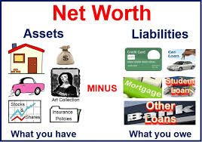
Net Worth
Net Worth or Owner’s Equity =
total assets minus total liabilities

Slide 20
Debt to Equity Ratio
A measure of a company or individuals net worth compared to the liabilities. Provides an indicator of the debt and equity a company is using to finance assets. Formula used to calculate Debt-to-Equity Ratio is: Debt-to-Equity Ratio = total liabilities / net worth.

Slide 21
Inventory
Inventory- an itemized list of things owned by a business with the beginning value and depreciated value.
Non-Depreciable- items that will be used up or sold within a year. Example: feed, supplies, medicine, fertilizer, etc.
Depreciable- items that have a useful life of more than one year and lose value because of age, wear or becoming out-of-date because of technology advancements.
Land is NOT depreciable property.

