Slide 1
Unit B: Animal Anatomy & Physiology
Essential Standard 3.00: Understand anatomy and physiology of agriculture animals.

Slide 2
Objective 3.01
Classify anatomy of body systems

Slide 3
Body System Structure
Organisms
begin as a single cell
created from the fertilized ovum
As cells divide and grow
they differentiate into various tissues
serve various functions in the body

Slide 4
Body System Structure
There are essentially 5 tissues found in the body:
Muscle
contractile tissue that allows for movement of the animal
Connective
holds various tissues together such as bone
Nerve
tissue that transmits information to various parts of the body
Epithelial
tissue that covers other tissue such as skin
Fluid
liquid type tissue such as blood

Slide 5
Body System Structure
Tissues work together to form the organs
sustain life and serve various functions
Each body system
will have a variety of the different tissues
each depending on the other to function normally

Slide 6
Skeletal System Anatomy
Functions:
protect vital body organs
give form or shape to body
Major parts include:
Bones
Cartilage
Teeth
Joints

Slide 7
Kinds of Bone
Cancellous Bone
Also known as spongy bone
Soft bone tissue filled with holes that are surrounded by hard bone
typically found at the end of long bones

Slide 8
Kinds of Bone
Compact Bone
consists of a structure known as the Haversian system
This system is a hard, protective layer of bone tissue that surrounds bone marrow

Slide 9
Types of Bone
Classified based on the shape or structure
Long
long cylindrical shaped bones that support the body
femur
Short
cube shaped bones
carpus/knee

Slide 10
Types of Bone
Flat
long, wide bones that protect vital organs
scapula
Pnuematic
contains sinuses (spaces) that come into contact with atmosphere
face bones

Slide 11
Types of Bone
Irregular
various shapes that protect and support the nervous system
vertebrae
Sesamoid
flat and round shaped bones
Located along tendons
patella

Slide 12
Components to the Skeletal System
Axial Skeleton
Close to the midline of the animal
Vertebral Column
Cervical vertebrae- section closest to the skull
Thoracic vertebrae
Lumbar vertebrae
Sacral vertebrae
Coccygeal vertebrae- tail section
Ribs
Sternum
Breastbone, keel bone
Skull

Slide 13
Components to the Skeletal System
Appendicular Skeleton
Project from midline of the animal
Pectoral Limb- front limb of the animal
Scapula- shoulder blade
Humerus- arm
Radius and ulna- forearm
Carpals- knees of the forelimb
Metacarpals- feet/hoof
Phalanges- toes
Pelvic Limb- hind limb of the animal
Femur- upper leg bone
Tibia and fibula- lower leg bones
Tarsals- hocks
Metatarsals- feet/hoof
Phalanges- toes

Slide 14
Muscular System Anatomy
Functions
provide movement
form
generates heat for animals
support of life through the digestive and respiratory systems
Lean portion of the carcass of meat animals used for human food

Slide 15
Classes of Muscles
Voluntary
under control of the animals will
Involuntary
not under control of the animals will

Slide 16
Types of Muscle
Striated
voluntary and involuntary muscles
attached to the skeleton by tendons
Also known as skeletal muscle
Most meat consumed by humans is striated muscle tissue
Makes up majority of muscle tissue in body

Slide 17
Types of Muscle
Smooth
involuntary muscle
found in internal organs and blood vessels
Acts more slowly than other muscle types
Can react to stimuli other than nerve endings such as chemicals and/or hormones
Cardiac
involuntary muscle found in the heart

Slide 18
Respiratory System Anatomy
Functions
provide oxygen to tissues
removal of carbon dioxide
controls temperature
voice production (“talking-” squealing, mooing, etc.)

Slide 19
Respiratory System Anatomy
Major Organs Include:
Nostrils
draw in air
Nasal cavity
air is warmed and moistened while dust particles are filtered out
smell
Pharynx
site where air and food passages are joined and split into respective parts
Larynx
cartilage structures that contain vocal cords
Trachea
tube that connects larynx to bronchi

Slide 20
Respiratory System Anatomy
Major Organs Include
Bronchi
two branch shaped structures that connect trachea to each lung
Bronchioles
smaller branches inside lungs
Alveoli
thin microscopic sacs located at the terminal end to respiratory system
location of actual carbon dioxide and oxygen exchange
Lungs
large lobed organs that contain parts essential for oxygen exchange
spongy, pinkish colored organ located between the front legs of the animal and extends to the abdominal area
Diaphragm
large muscle separating the chest from the abdomen and aids in the respiration process

Slide 21
Circulatory System Anatomy
Functions
supply body tissues with nourishment
collect waste materials from body tissues
transports hormones and cells of the immune system

Slide 22
Circulatory System Anatomy
Major Organs/Parts Include
Heart
major involuntary muscle
pumps blood throughout the circulatory system
large reddish colored organ located just behind the shoulder on the left side of the animal
Arteries
small tube-like structures that carry blood from the heart to organs and tissues throughout the body
Veins
small tube-like structures that carry blood to the heart from organs and tissues
Capillaries
vessels that exchange nutrients, oxygen, carbon dioxide, waste products, etc. from the arteries and/or veins

Slide 23
Circulatory System Anatomy
Lymphatic System
works with circulatory system
carries lymph fluid from vessels and glands to the capillaries that feed into the circulatory system

Slide 24
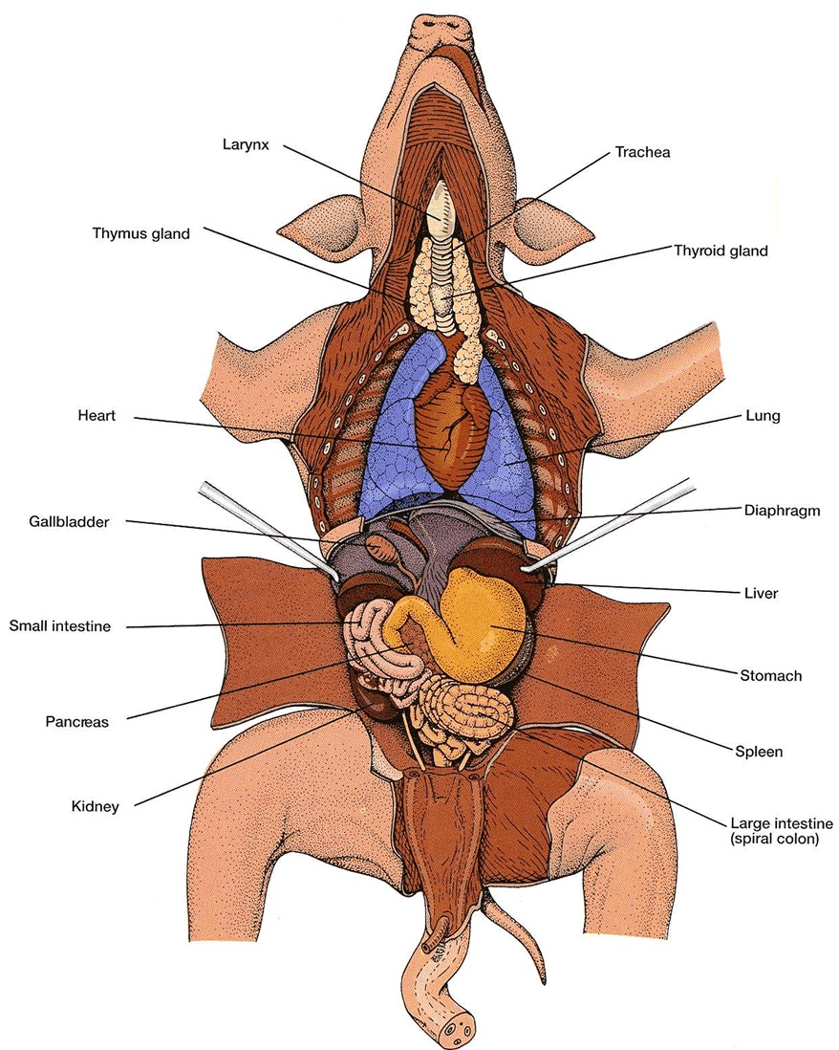

Slide 25
Nervous System Anatomy
Functions
coordinate the physical movement of the body
responds to hearing, sight, smell, taste, and touch
reacts to internal and external stimuli

Slide 26
Nervous System Anatomy
Major Parts/Organs Include
Central Nervous System
functions to coordinate and control body activities
Includes the brain and spinal cord

Slide 27
Nervous System Anatomy
Major Parts/Organs Include
Peripheral Nervous System
includes all the nerves that send messages to and from the central nervous system

Slide 28
Nervous System Anatomy
Two basic types of nerves:
Somatic Nerves
voluntary process of relaying information between skin, skeletal muscles and the central nervous system
Reflexes are also somatic nerves, but are controlled involuntarily
Autonomic Nerves
involuntary process of relaying information from central nervous system to organs

Slide 29
Endocrine System Anatomy
Function
works with the nervous system to control internal body functions
affects and controls growth, reproductive functions (heat, lactation, birth, etc.), shape of the animal’s body, feed efficiency and adaptation to environment
Hormones are primary substance involved in function of endocrine system

Slide 30
Endocrine System Anatomy
Major Organs/Parts Include
Pituitary Gland
major gland of the endocrine system
regulates the other hormones involved in the endocrine system
Ovaries
secrete hormones such as estrogen and progesterone
involved in the estrus cycle, gestation and parturition
Testicles
secrete hormones such as testosterone
involved in the production of sperm, sex drive and development of male body characteristics.

Slide 31
Endocrine System Anatomy
Major Organs/Parts Include
Thyroid Gland
secretes the hormone thyroxin that stimulates growth and metabolism
Hypothalamus
secretes hormones involved in the reproductive cycle
Adrenal Glands
secrete hormones such as adrenaline that respond to stress

Slide 32
Urinary System Anatomy
Functions
filter fluid
removes waste

Slide 33
Urinary System Anatomy
Major Organs/Parts Include
Kidneys
blood passes through and waste products and water are removed
urine is the combination of this liquid and waste products
Ureters
the liquid (urine) from the kidneys travel through tube-like structures called ureters to the bladder
Bladder
stores urine
Urethra
tube-like structure that excretes the urine waste

Slide 34
Urinary System Anatomy
Poultry
Do not have a bladder or urethra
ureters are directly connected to the cloaca
where solid and liquid wastes are excreted

Slide 35
Objective 3.02
Summarize physiology of body systems

Slide 36
Skeletal System Physiology
Formation of Bone
Embryo skeletal development begins as cartilage
Cartilage
tough yet flexible and elastic connective tissue
As the mammal develops, most cartilage is replaced as bone tissue
remaining cartilage is found in joints or other specialized structures

Slide 37
Skeletal System Physiology
Bone Composition
26% minerals- calcium compounds
50% water
4% fat
20% protein
Transformation of cartilage
occurs when specialized cells called osteocytes break down the cartilage and replace it with bone tissue

Slide 38
Skeletal System Physiology
Bone tissue contains
blood, lymph vessels and nerve fibers that continue to grow and repair themselves over the life of the animal
Bone tissue requires
adequate nutrition to function properly

Slide 39
Muscular System Physiology
Striated Muscle
contains dark bands that cross each muscle fiber
Exist in bundles that are enclosed in connective tissue called the perimysium
perimysium contains cylindrical shaped muscle fibers called sarcoplasm
Each fiber is contained in a sheath known as the sarcolemma
Muscle is covered by a sheath of connective tissue called the epimysium

Slide 40
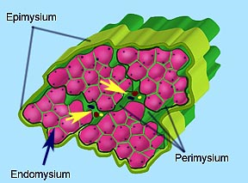
Muscular System Physiology
Source: http://www.lab.anhb.uwa.edu.au/hsd212/02weekpages/WK04/week04_4labHistP00.htm

Slide 41
Muscular System Physiology
Myofibrils are the components of the muscle fiber
Myofilaments are found in the myofibril
Nerve endings are located on every muscle fibril
Muscle contracts when stimulated by an impulse from the nerve
Energy for muscle contraction comes from ATP (adenosine triphosphate)
The muscle contraction process generates heat for the body

Slide 42
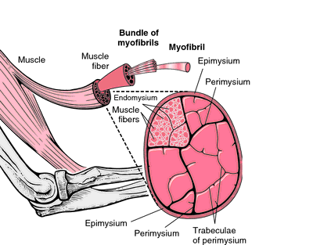
Muscular System Physiology
Source: http://medical-dictionary.thefreedictionary.com/myofibril

Slide 43
Muscular System Physiology
Smooth Muscle
activated by the autonomic nervous system
Do not contain the myofibrils or dark bands found in skeletal muscle
The cellular structure of smooth muscle is smaller and more spindle shaped as compared to striated muscle
Myofibrils are replaced by bundles of thick filaments

Slide 44
Muscular System Physiology
Cardiac Muscle
functions similar to striated muscle except fibers are interconnected

Slide 45
Respiratory System Physiology
Animal breathes by using diaphragm and rib muscles to enlarge the chest cavity
Air enters through the mouth and nasal cavity
Pharynx and larynx
Larynx
contains vocal cords
As air passes over the vocal cords, sound is produced by the animal

Slide 46
Respiratory System Physiology
Air travels down through trachea, bronchi, and bronchioles to clusters of air sacs called alveoli
Alveoli are surrounded by minute blood vessels called capillaries
Capillaries pick up oxygen through the thin walls of the alveoli
Oxygen goes into the bloodstream and locks onto red blood cells
Heart pumps oxygen rich red blood cells to other tissues throughout the body
Bloodstream then picks up carbon dioxide
carries it to the alveoli where the gas is again exchanged and removed through the trachea

Slide 47
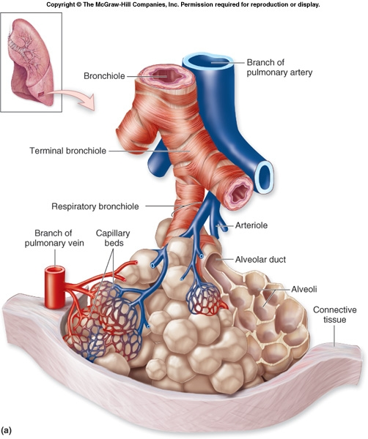
Respiratory System Physiology

Slide 48
Circulatory System Physiology
Heart is the major circulatory system organ and pumps blood throughout the animal’s body
Blood flow through the heart:
Contractions of the heart begin in the atria and proceed to the ventricles.
The contraction and relaxation of the heart forces blood to move through the circulatory system.
Mammals have four chambers:
Left and right ventricles- in the lower part of the heart.
Left and right atria- in the upper part of the heart.
Valves between the atria and ventricles keep blood flow moving in one direction.

Slide 49
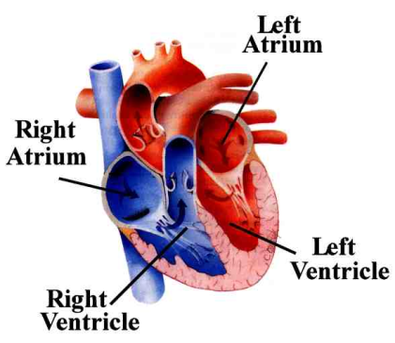
Circulatory System Physiology
Steps in Blood Flow:
Blood enters the right atrium:
Cranial/Superior/Anterior vena cava-head area
Caudal/Inferior/Posterior vena cava-lower body
This blood is low in oxygen and high in carbon dioxide (deoxygenated blood)
Contraction of the right ventricle forces the blood into the pulmonary artery
carries the deoxygenated blood to the lungs

Slide 50
Circulatory System Physiology
Steps in Blood Flow:
Gas exchange takes place in the lungs
Blood is sent back to the heart through the pulmonary veins
Pulmonary veins enter the left atrium of the heart
Left atrium contracts and forces blood into the left ventricle
Aorta then carries oxygenated blood to the body

Slide 51
Circulatory System Physiology
Blood
Circulates throughout the body through veins and arteries.
Major Functions Include:
Transport nutrients from digestive system
Transport oxygen from the lungs
Transport waste products
Helps regulate body temperature
Transport hormones
Help protect body against disease and organisms by transporting immune cells

Slide 52
Nervous System Physiology
Neurons
cells that conduct impulses in the nervous system
control different parts of the reaction to stimuli based on their type and function:
Sensory Neurons
impulses from internal and external stimuli to the brain and spinal cord
Interneurons
processes the impulses received from sensory neurons inside of the brain and spinal cord
Motor Neurons
carry the impulses away from the brain and spinal cord

Slide 53
Nervous System Physiology
Stimuli Response Example
Receptors in the skin identify touch or other stimuli
Sensory neurons carry stimuli message to the brain and spinal cord
The interneurons in the brain process the “message” and determine a response
Motor neurons transmit a response reaction to the stimulated tissue.

Slide 54
Endocrine System Physiology
Hormones in the animal’s body control various body functions such as growth, reproductive functions, feed efficiency, etc.
Hormones
chemical substances that affect glands and organs in the body
passed into the bloodstream as the blood passes through various glands in the animal’s body
Glands
cells or groups of cells that secrete fluids
Hormones travel to organs in the body which stimulates a response
Example: estrogen stimulates heat behavior “response”

Slide 55
Urinary System Physiology
Blood in the animal’s body passes through the kidneys
Waste products are removed and water is collected to form liquid waste (urine)
Urine containing the waste products travels through the ureters to the bladder
Urine is stored in the bladder
Urethra
excretes urine

Slide 56
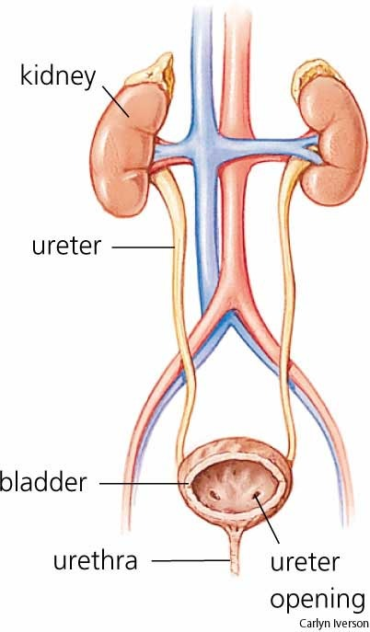
Urinary System Physiology

Slide 57
Unit B: Animal Anatomy & Physiology
Essential Standard 4.00: Understand reproductive and digestive physiology.

Slide 58
Objective 4.01
Understand reproductive physiology.

Slide 59
Female Livestock Reproductive Physiology
Estrous Cycle
length of the animal’s reproductive cycle from one estrus to the next
cattle and swine
21 days

Slide 60
Female Livestock Reproductive Physiology
Estrus
period of receptivity to the male
Cow
about 16-18 hours
Sow
about 2 days

Slide 61
Female Livestock Reproductive Physiology
Signs of heat
Cattle
swelling of the vulva
frequent urination
nervousness or restlessness
mounting other animals
letting other animals mount
The best indication that a cow is ready to breed is when she stands when mounted

Slide 62
Female Livestock Reproductive Physiology
Swine
restless activity
swelling of the vulva
discharge from the vulva
frequent urination
occasional loud grunting

Slide 63
Female Livestock Reproductive Physiology
Ovulation
release of ova (egg) from ovary
beginning (day 1) of female’s cycle

Slide 64
Female Livestock Reproductive Physiology
Ovaries
produce ova
produces estrogen and progesterone
Number of young that animals give birth to at one time is indication of number of eggs released or ovulated
Sows- 10-15
Cows- 1

Slide 65
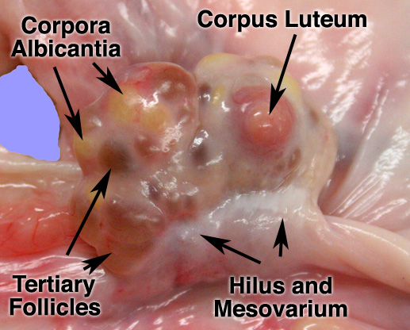
Female Livestock Reproductive Physiology
http://www.ansci.wisc.edu/jjp1/ansci_repro/lab/lab1/pig_2010/ovary.htm

Slide 66
Female Livestock Reproductive Physiology
Each ovary houses hundreds of follicles where ova develop
The largest follicle is usually the one that is ready for ovulation
Forms the corpus luteum shortly after ovulation
releases hormone progesterone
If sperm are not present, the corpus luteum does not persist

Slide 67
Female Livestock Reproductive Physiology
Estrogen- released by cells lining the follicle
Transported in the blood stream and causes numerous reactions in the animal’s body:
Increases sensitivity in the uterus
Aids in the transport of semen
Mucus secretion in the cervix to lubricate the vagina
Signals signs of heat displayed by the animal

Slide 68
Female Livestock Reproductive Physiology
Progesterone- produced 5-6 days after ovulation and released by cells in the corpus luteum
If fertilization occurred, progesterone:
Stops other eggs from forming and prevents estrus while animal is pregnant
Regulates production of follicle stimulating hormone (FSH) and lutenizing hormone (LH)
Allows egg to implant in the uterus
Maintains pregnancy
Encourages development of mammary glands

Slide 69
Female Livestock Reproductive Physiology
If fertilization does not occur because sperm were not present or the body did not recognize the pregnancy, between day 15-16 the hormone prostaglandin:
Stops production of progesterone
Corpus luteum regression
Stimulates increase release of follicle stimulating hormone (FSH) and lutenizing hormone (LH) from the pituitary gland in the brain and the animal will continue the estrous cycle in preparation for the next heat and ovulation.
FSH stimulates growth of follicles
LH stimulates estrogen production which brings animal back into estrus

Slide 70
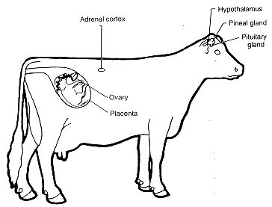
Female Livestock Reproductive Physiology

Slide 71
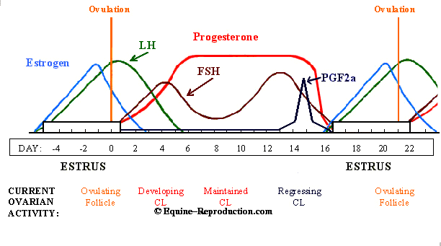
Female Livestock Reproductive Physiology

Slide 72
Embryo and Fetal Development
Day 1-2- spermatozoa travel into reproductive tract and ova is released and travels from ovary to oviduct through the infundibulum so fertilization can occur
The fertilized ovum is now referred to as a zygote and travels towards the uterus during the first 4-5 days of the estrous cycle. Uterine fluids surround the zygote.
The animal’s body sends chemical signals to maintain levels of progesterone and retain the corpus luteum

Slide 73
Embryo and Fetal Development
The zygote continues to float freely in the uterus and develop membranes that become the placenta
Placental attachment occurs around day 30 in the cow and the embryo continues to develop for the remainder of the gestation period
Near the end of gestation, the corpus luteum reduces production of progesterone which causes an increase in estrogen production
Estrogen along with other hormones stimulates contractions which begins the birthing process

Slide 74
Parturition
Occurs in 3 phases
Preparatory Stage
females prepares to give birth
Shows signs of restlessness, raising tail, separation from other animals and mucus discharge.
Mild uterine contractions may be observed
Fetus rotates to birthing position
Cervix begins to dilate and the some part of fetus enters birth canal depending on fetal presentation (front legs, rear legs, etc.)
Some fetal membranes may be visible when examining vulva

Slide 75
Parturition
Expulsion Stage
fetus is expelled
Uterus increases frequency and force of contractions
Fetus is in birth canal and delivery should occur quickly.
Presentation of fetus varies between species:
Cattle- front feet, nose, head, shoulders, body, hips and back legs
Swine- no set presentation
Dystocia- an abnormal or difficult birth
Causes:
Animals that do not enter the birth canal in a normal presentation
Selection of animals with larger frame size than the female can manage

Slide 76
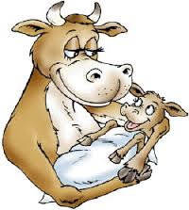
Parturition
Cleaning Stage
expelling afterbirth
Retention of afterbirth will lead to infection and potentially death of the mother
After proper cleaning the uterus shrinks back to normal size (involution) and animal begins to cycle again

Slide 77
Objective 4.02
Understand digestive physiology.

Slide 78
Digestive System Physiology Terminology
Enzymes
organic catalyst substances that speed up the digestive process
Rumination
process of forcing food back up the esophagus to be chewed again
Occurs only in ruminant animals
“chewing the cud”

Slide 79
Digestive System Physiology Terminology
Bacteria and Protozoa
one-celled organisms
found in the rumen and reticulum and aid in digestion
Amino Acids
compounds that are the building blocks of protein
contain carbon, hydrogen, oxygen and nitrogen
essential for growth and maintenance of cells

Slide 80
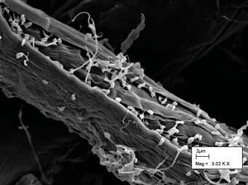
Digestive System Physiology Terminology
Bacterium attacking a plant fiber. Photo by Lydia Joubert. USDA publication

Slide 81
Digestive System Physiology Terminology
Villi
small finger-like projections in the intestinal wall
increase the surface area
aid in digestive absorption
Gastric Juice
liquid that contains water, mucus, hydrochloric acid and digestive enzymes
secreted by glands

Slide 82
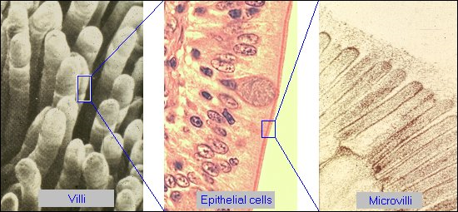
Digestive System Physiology Terminology
http://www.vivo.colostate.edu/hbooks/pathphys/digestion/smallgut/anatomy.html

Slide 83
Digestive System Physiology Terminology
Chyme
partially digested feed that is acidic, semi fluid, gray, and pulpy
produced in stomach and sent to small intestine
Prehension
process of grasping feed with lips tongue and/or teeth

Slide 84
Digestive System Physiology
Mouth, Teeth Tongue and Salivary Glands
Mouth and teeth masticate (chew) food to increase surface area of food particles
Saliva in mouth stimulates taste and softens and lubricates food
also contains salivary amylase and maltase enzymes to help change some starch to maltose (malt sugar)

Slide 85
Digestive System Physiology
Mouth, Teeth Tongue and Salivary Glands
Ruminants swallow food rapidly without chewing food adequately
They then ruminate feed
Tongue guides feed to esophagus and can also aid in prehension for some species

Slide 86
Digestive System Physiology
Esophagus
carries food from mouth to stomach through a series of muscular waves or contractions

Slide 87
Digestive System Physiology
Rumen and Reticulum
Responsible for breaking down forages
Ruminants will lie down to initiate rumination
5-7 hours per day
Contain microbes that convert low quality protein from forages into amino acids

Slide 88
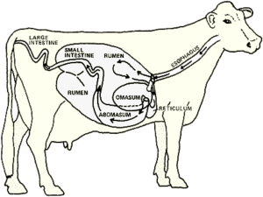
Digestive System Physiology
Rumen and Reticulum
Large amounts of gas are produced in rumen (30-50 liters per hour)
must be belched or expelled to prevent ruminants from bloating

Slide 89
Digestive System Physiology
http://agsciencelc.blogspot.com/2013/06/digestive-systems.html

Slide 90
Digestive System Physiology
Rumen and Reticulum
Cattle often swallow foreign objects such as nails or wire because they eat rapidly and do not use lips to discriminate among food particles
Hardware disease
common term for animals that become ill from foreign objects
Prevented by inserting small magnet into reticulum
Holds foreign objects to prevent them from penetrating the heart

Slide 91
Digestive System Physiology
Omasum
Very little digestive action occurs in omasum
Feed is primarily ground and squeezed
Liquid is removed

Slide 92
Digestive System Physiology
Stomach, Abomasum and Proventriculus
breaks down finer feed particles
Gastric juices secreted when feed enters stomach/abomasum/proventriculus
Contain hydrochloric acid which stops action of salivary amylase
Contain additional enzymes that break down feed
Pepsin- acts on proteins
Gastric lipase- acts on fats

Slide 93
Digestive System Physiology
Stomach, Abomasum and Proventriculus
Muscular walls help churn and squeeze feed forcing liquids into small intestine
Gastric juices then continue to break down remaining or new feed
Very little feed gets “processed” in the proventriculus because poultry swallow food whole

Slide 94
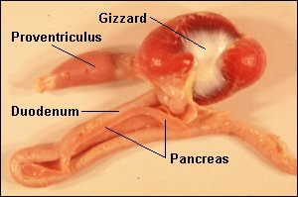
Digestive System Physiology
Gizzard
Muscular contractions and grit/gravel break down feed
Digestive juices from proventriculus continue to act on feed
http://www.vivo.colostate.edu/hbooks/pathphys/digestion/birds/

Slide 95
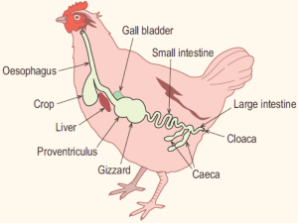
Digestive System Physiology
http://agsciencelc.blogspot.com/2013/06/digestive-systems.html

Slide 96
Digestive System Physiology
Small Intestine
Primary site of nutrient absorption for nonruminants and ruminants
Villi line intestinal wall to increase surface area and aid in absorption of nutrients

Slide 97
Digestive System Physiology
Small Intestine
Chyme mixed with pancreatic juices, intestinal juices and bile
Pancreatic Juice
Trypsin- enzyme that breaks down remaining proteins.
Pancreatic amylase- changes starch that was not processed by salivary amylase into maltose.
Lipase- acts on fats to convert them into fatty acids.

Slide 98
Digestive System Physiology
Small Intestine
Intestinal Juice
Secreted by intestinal wall
Secretes several enzymes that break down proteins and sugars
Bile
Produced by the liver
Stored in the gall bladder
Yellowish green fluid
Acts on fats and fatty acids

Slide 99
Digestive System Physiology
Cecum
Bacterial action breaks down roughage for horses
Serves little function for other nonruminants and ruminants

Slide 100
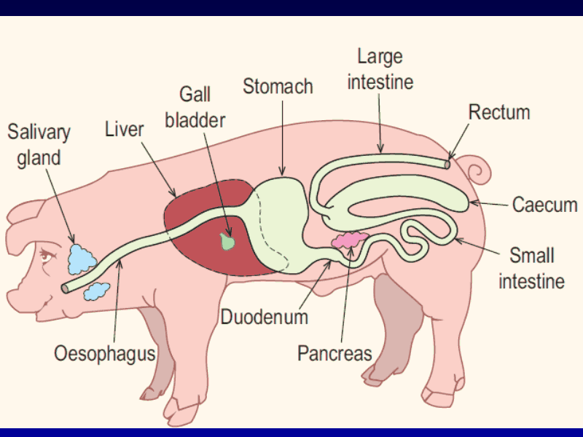
Digestive System Physiology
http://agsciencelc.blogspot.com/2013/06/digestive-systems.html

Slide 101
Digestive System Physiology
Large Intestine
Primary site of water absorption and formation of feces
Some enzymatic and microbial digestion occurs on any remaining feed

